Slide 1

Mammoth Cave National Park

Slide 2
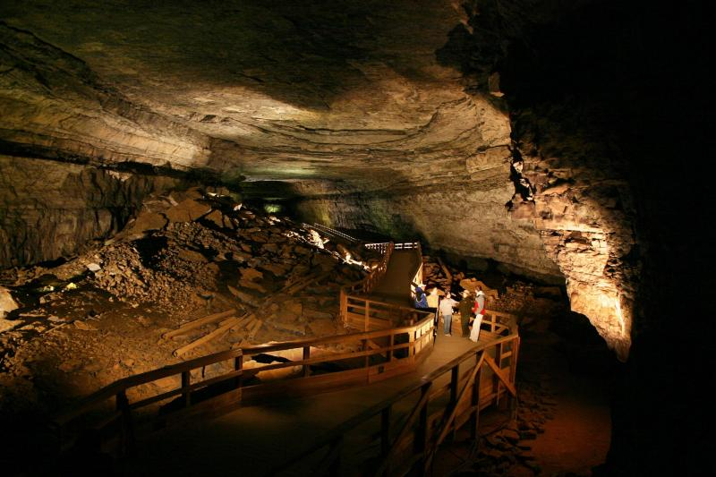
Location of the cave
It is located in Kentucky, USA

Slide 3
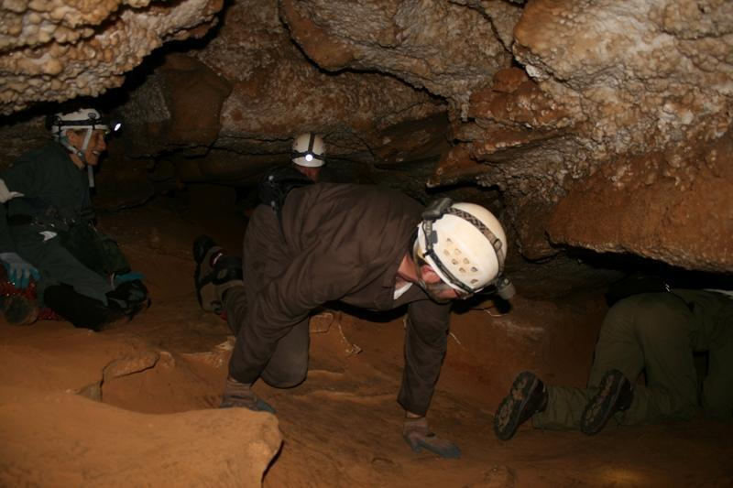
About the cave
Mammoth cave is a limestone labyrinth kind of cave
It receives over 2.5 million visitors every year and some of them go into the caves therefore, can be visited
Over 400 miles of the cave have been explored out of the total estimate of 600 miles

Slide 4
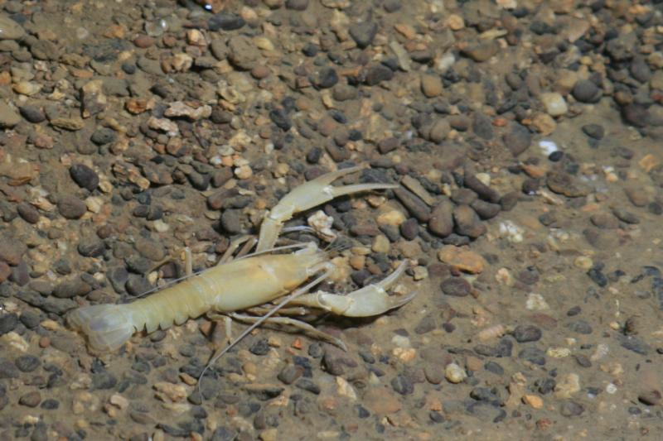
Creatures that live in the cave
Crayfish are found in streams that run through the underground part of the cave

Slide 5
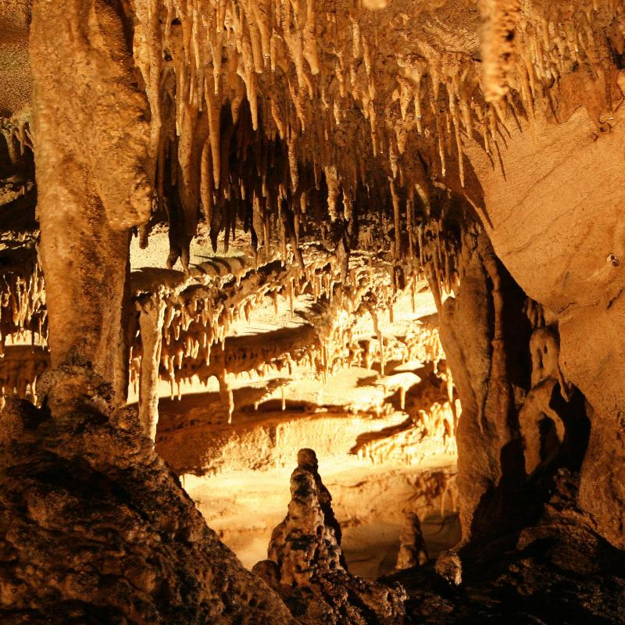
Interesting facts
It is the worlds longest cave
More than 130 wildlife species inhabit the cave
African-Americans were the first cave guides

Slide 6
References
Mammoth Cave National Park (U.S. National Park Service). (2019). Retrieved from https://www.nps.gov/maca/index.htm
Mammoth Cave: Explore the World’s Longest Cave. (2017). Retrieved from https://www.doi.gov/blog/mammoth-cave-explore-worlds-longest-cave

